Slide 1
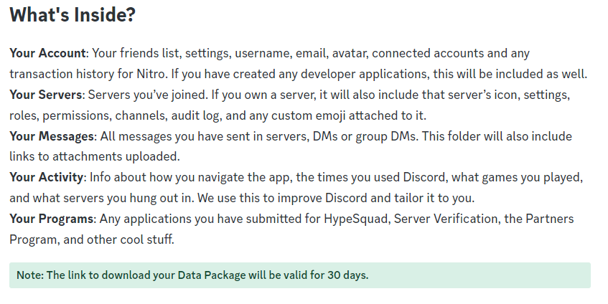
Notes:
Discord Data Download:
Go to Google and search “How to get my data download for Discord?”

Slide 2
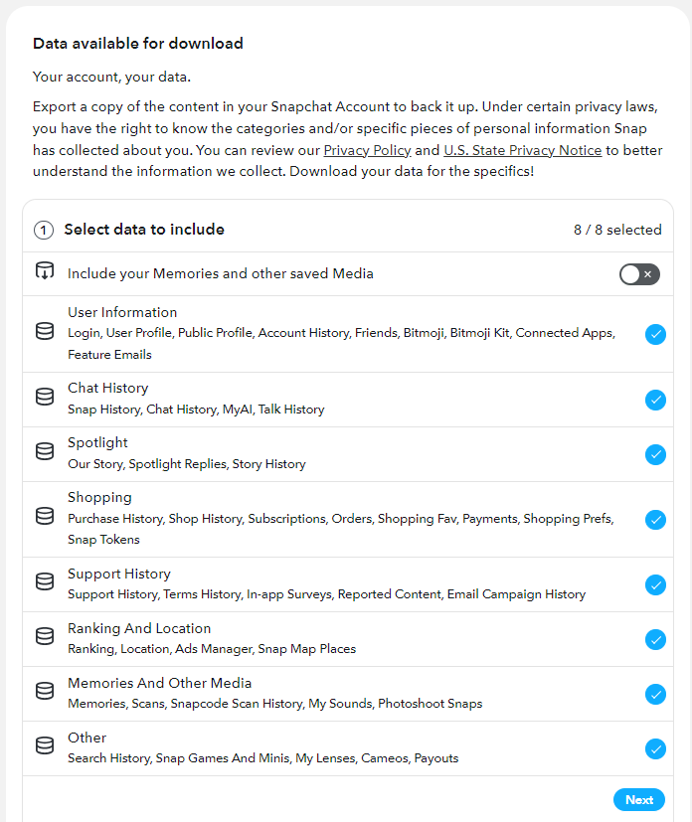
Notes:
Snapchat Data Download:
Go to Google and search “How to get my data download for Snapchat?”

Slide 3
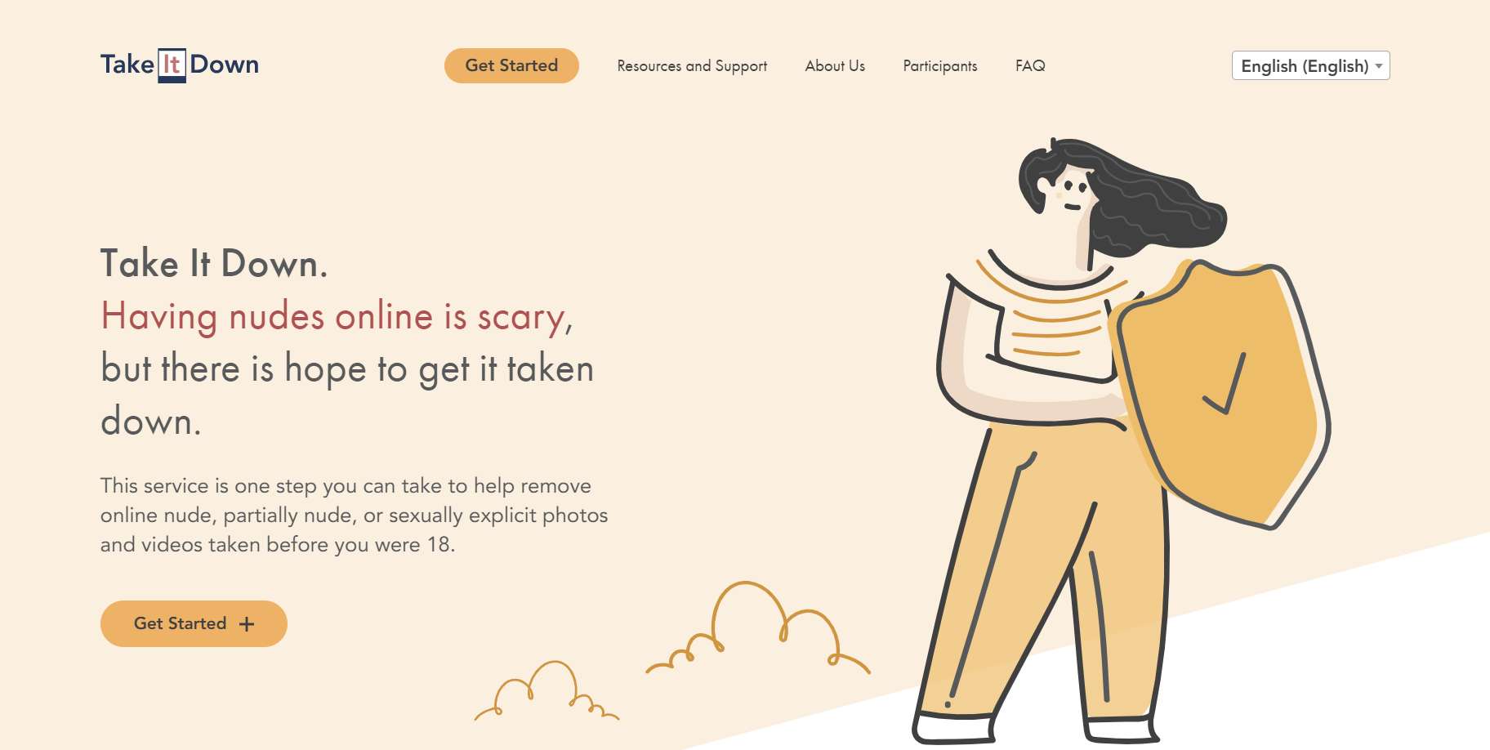

Slide 5
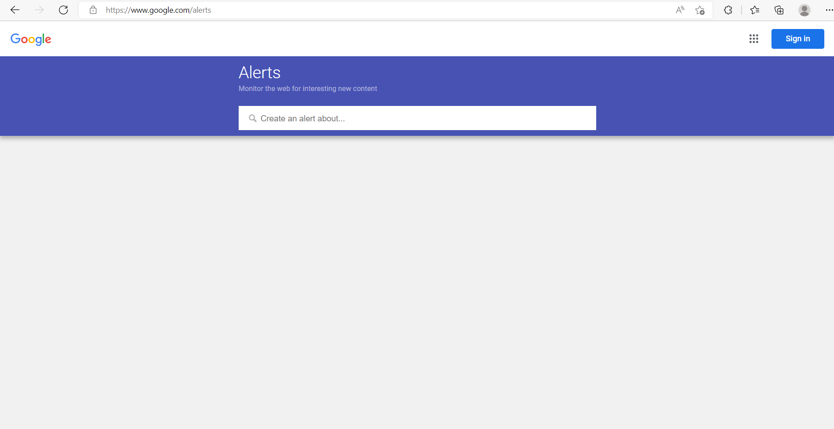
google.com/alerts
Notes:
Create alerts for your children’s social media usernames, or the celebrities they follow.

Slide 6
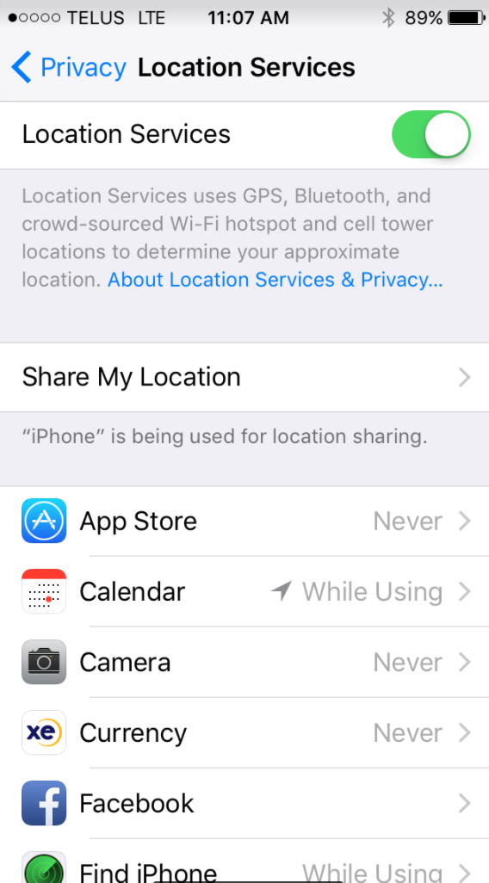
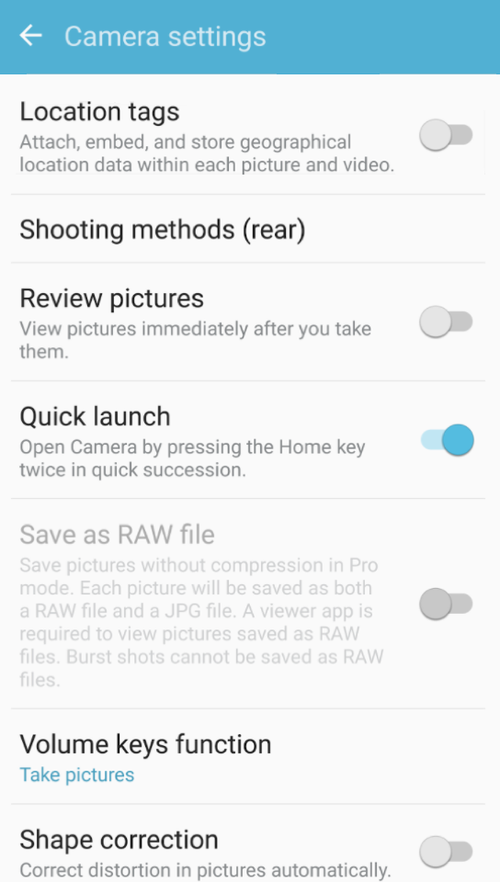
Apple
Settings
Privacy
Location Services
Camera (NEVER)
Android
Camera
Settings
Location
Tags (OFF)
Notes:
Take out phone and make sure location services are off to prevent the metadata on photos.
IPHONE
-Settings
-Privacy
-Locations Services
-Camera (OFF)
Samsung
-Click on your camera
-Settings
-Locations Tags (OFF)

Slide 8
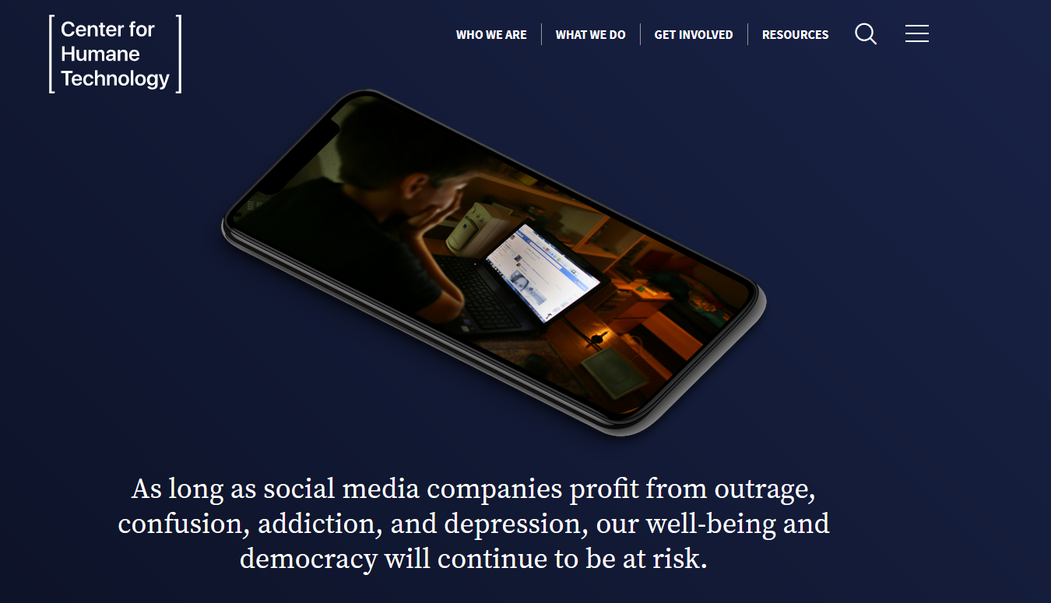
www.humanetech.com
Notes:
https://www.youtube.com/watch?v=WAq4oS2OZM4 → A Guide to Navigating Online Information

Slide 9
In the iPhone app: Tap on Menu – the three horizontal lines in the lower right corner of your main screen.
Or in the Android app, tap on the three horizontal lines in the upper right corner of your main screen.
On the next screen, choose the icon that looks like a gear in the upper right corner.
Then under Preferences → Media → and select the option that says “Never Autoplay Videos.”
Facebook

Slide 10
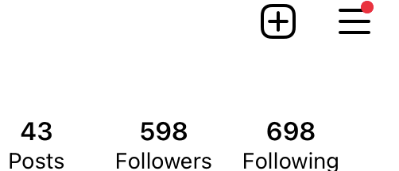
Click on your profile image in the lower right corner of your screen. Then from the upper right corner, tap on the three horizontal lines.
Go to Settings and privacy → Suggested content → Sensitive content.
Choose “Less” and Instagram will show fewer posts that it considers potentially sensitive. If you change this setting, you may still see graphic images from accounts that you follow.
Instagram

Slide 11
“Restricted Mode” helps limit graphic videos from the For You Page. You may also see a warning about “Sensitive content” and can choose to click to watch or skip the TikTok video.
Tap on your profile in the lower right corner. Then click on the three horizontal lines in the upper right.
Pick the option for Settings and privacy → Content preferences → Restricted Mode. You’ll need to set a passcode to turn Restricted Mode on or off.
TikTok

Slide 12
On Youtube.com: When a video is playing, hover your cursor to the bottom of the video. You’ll see in the middle an auto play button with an image for pause. Click that to automatically stop playing one video after another.
YouTube has more instructions here. YouTube also said that in some cases, it may apply a warning to videos before they start playing.
Another option in YouTube’s iPhone and Android app: Click on your profile in the upper right corner.
Choose Settings → Autoplay. Tap off to stop one video from automatically playing when you finish another.
Another option: Settings → General → Restricted mode. Tap on to hide videos on that particular device that YouTube considers “potentially mature.”
YouTube

Slide 13
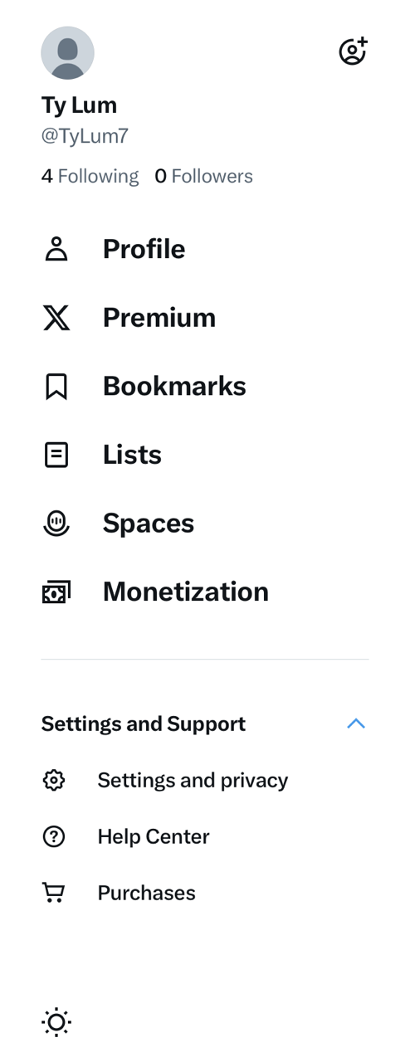
From the top left side of the screen, choose the image of your profile picture.
Choose Settings and Support → Settings and privacy → Privacy and safety → Content you see.
Uncheck the box that says “Display media that may contain sensitive content.”
Another option is to stop videos from playing automatically as you scroll. From the top left side of the screen, choose the image of your profile picture.
Choose Settings and Support → Settings and privacy → Accessibility, display and languages → Data usage → Autoplay. Select “Never” to stop videos from playing automatically as you scroll.
X, formerly known as Twitter

Slide 14
WhatsApp
You can mute notifications for a WhatsApp group, which means you won't be alerted to new messages. You can resume notifications later if you choose. WhatsApp has instructions here.
You can also block individuals in your group chat or report material in the group to WhatsApp if you believe it is inappropriately violent or manipulated information. Those instructions are here.
Or you can leave a WhatsApp group. If you do so, only the administrators of that group chat are notified.

